Slide 1
Merge Sort

Slide 2
Introduction
Merge sort is a famous sorting algorithm.
It uses a divide and conquer paradigm for sorting.
It divides the problem into sub problems and solves them individually.
It then combines the results of sub problems to get the solution of the original problem.

Slide 3
Divide and Conquer Strategy
Suppose we had to sort an array A. A subproblem would be to sort a sub-section of this array starting at index p and ending at index r, denoted as A[p..r].
Divide - If q is the half-way point between p and r, then we can split the subarray A[p..r] into two arrays A[p..q] and A[q+1, r].
Conquer - In the conquer step, we try to sort both the subarrays A[p..q] and A[q+1, r]. If we haven't yet reached the base case, we again divide both these subarrays and try to sort them.
Combine - When the conquer step reaches the base step and we get two sorted subarrays A[p..q] and A[q+1, r] for array A[p..r], we combine the results by creating a sorted array A[p..r] from two sorted subarrays A[p..q] and A[q+1, r].

Slide 4
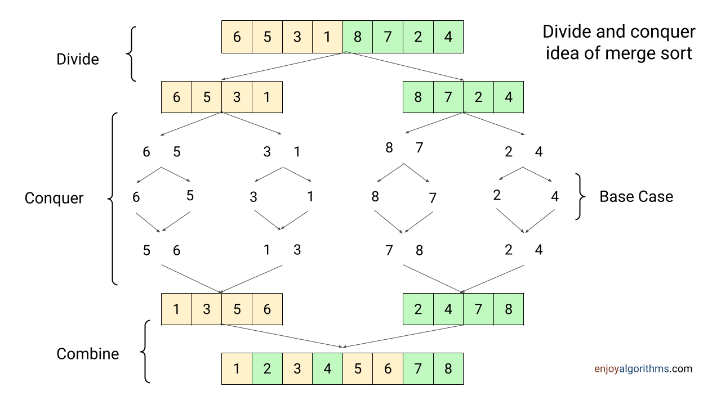

Slide 5
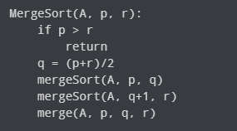
MergeSort Algorithm
The MergeSort function repeatedly divides the array into two halves until we reach a stage where we try to perform MergeSort on a subarray of size 1 i.e. p == r.
After that, the merge function comes into play and combines the sorted arrays into larger arrays until the whole array is merged.

Slide 6
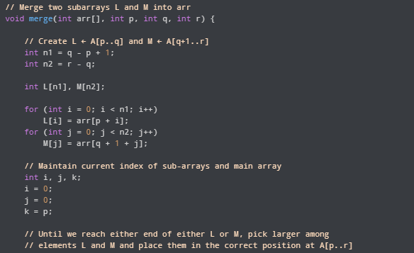
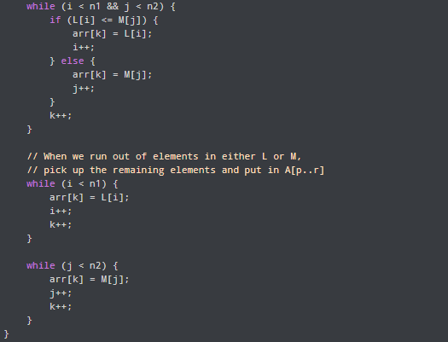
Merge( ) Function

Slide 7
Merge Sort Complexity
Time Complexity
Best Case Complexity: O(n*log n)
Worst Case Complexity: O(n*log n)
Average Case Complexity: O(n*log n)
Space Complexity
The space complexity of merge sort is O(n).

Slide 8
Example-1
Consider the following elements have to be sorted in ascending order-
6, 2, 11, 7, 5, 4

Slide 9
